Slide 1

assessment development SESSion
July 30th – August 2nd, 2012
Renee M. Burnett
rburnett@ocmboces.org
OCM BOCES Network Team Facilitator
Notes:
Clarify for participants that the work over the next four days is district-developed in nature and NOT a BOCES or Regionally developed assessment. We are only providing the venue/space for their work.

Slide 2

Who are we?

Slide 3
Building Shared Knowledge
Collaboratively constructing a summative assessment
Day 1
Days 2-4
Work Flow
Notes:
Review the expected work flow for the session. We will be building shared knowledge around standards, identifying learning targets, and quality assessment design.

Slide 4
Regulations
BCIC- Representative group of component districts
Matching- two districts for each course/level
How did I end up here?

Slide 5
Only districts that participate (won’t be sold, shared with others)
Summer and early fall sessions
Given electronically to district BCIC representative (see handout)
How will my work be shared?

Slide 6
Assessment Creation
Agree on the Standards
Define what will be assessed
Develop appropriate assessment items
Your Task
Notes:
Show a final product to the group.

Slide 7
Be present
Be willing to listen
Recognize that there will be differences
Collaborate, not dominate
Stay positive!
Keep the goal in mind
Working Agreement

Slide 8
appr points
20%
Student
Growth
60%
Multiple Measures
20%
Student
Achievement
Notes:
The assessments created during these sessions are intended to be used for the 20% state-growth portion of the APPR process.
SLOs are required in the 20% Student Growth section of the APPR scale.
Note: For teachers with a value-added measure, SLOs are no longer an option for the local 20% Student Achievement. However, teachers could address this portion of the APPR using the Local Achievement Target (LAT) process (which is essentially setting an SLO but with a different name). If the LAT is used as a local measure, it “must measure something different from the teacher’s SLOs used in the 20% Student Growth comparable measure.”

Slide 9
Rigorous
Aligned to NYS Content Standards
Locally-comparable
Used across all classrooms in a district in the same grade or subject
Aligned to CCLS
SLO Summative Assessments
Notes:
Two terms often heard in the development of district-created assessments are “rigorous” and “locally-comparable”. NYSED defines them above.
Individual teachers can NOT create their own summative assessments to be used with their SLOs. For example, if I teach English 9 along with two other colleagues, we must collaboratively develop an assessment we will all use at the end of the course.

Slide 10
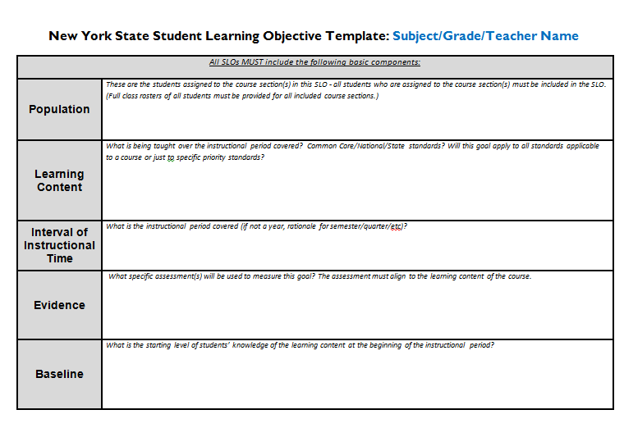
Notes:
Highlight the Learning Content portion of the SLO template. The Learning Content identified in the SLO must be based on Standards and/or district priorities and becomes the focus for the summative assessment.

Slide 11
State
National
Common Core
Must include
Which Standards?
Notes:
Participants must decide which standards they will use to base their summative assessment upon: State? National?
All assessments must include Common Core standards that have been identified as being relevant to the content area

Slide 12
Designing Quality Common Assessments
A Five Step Process
Decide What to Assess
Decide How to Assess
Develop Assessment Plan
Write the Assessment
Review the Assessment
Notes:
Outlined above is a five-step process adapted from the book Common Formative Assessments.

Slide 13
What do we want students to know and be able to do?
Decision Point 1

Slide 14
Read the Standards
Step 1
Step 2
Prioritize the Standards
Step 3
Unwrap the Standards
Step 4
Discuss the Standards
Examine the Standards
Notes:
A simple protocol for examining the standards in a systematic manner.

Slide 15
Read & Discuss
Which standards?
Why these standards?
Examine the language of the standard
Make connections
Steps 1 & 2
Notes:
Steps 1 and 2 are combined to highlight the collaborative nature of examining the standards. These are essential first steps in knowing what the standards actually say and how we interpret them within our own frame of reference.

Slide 16

Prioritizing the standards
Step 3

Slide 17
“The sheer number of standards is the biggest impediment to implementing the standards.”
The Case for Prioritizing Standards
Robert Marzano, 2001
Notes:
To emphasize the rationale for identifying and prioritizing Power Standards

Slide 18
Power Standards
Prioritized
Essential vs.
Nice-to-know
Safety net
Curriculum, instruction, & assessment are aligned to PS
What are Power Standards?
Notes:
According to Larry Ainsworth and Doug Reeves as quoted in Power Standards:
Prioritized: Power Standards are prioritized for the purpose of added instructional emphasis.
Essential vs. Nice-to-Know: Some standards are more important than others. Power Standards are considered to be esential or critical to student success.
Safety net: The Power Standards represent those skills and concepts that every teacher will ensure students learn prior to moving on to the next grade.
Curriculum, instruction, and assessment are developed with the Power Standards in mind

Slide 19
Essential
Taught & assessed with depth & frequency
Nice-to-Know
Taught & assessed in support of Power Standards
Additional time & support provided to students not demonstrating mastery
Prioritization, Not Elimination
Notes:
Let’s be clear: Prioritization and identification of the Power Standards does not mean teachers can ignore all other standards. It simply means the Power Standards will be taught & assessed deeply for mastery since they have been identified as “essential” or critical to student success. The “nice-to-know” standards are often embedded or nested within the Power Standards and can be given less emphasis.

Slide 20
Endurance
Leverage
Readiness for the next level of learning
Does the value extend beyond a single test?
Is the value multi-disciplinary?
Necessary for success in the next grade?
Criteria
Prioritizing the Standards
Notes:
These three criteria are from Doug Reeves.

Slide 21
School
Life
State Test
Does the value extend beyond a single test?
Is the value multi-disciplinary?
Necessary for success in the next grade?
Criteria
Prioritizing the Standards
Notes:
These three criteria are from Larry Ainsworth.

Slide 22
What essential understandings and skills do our students need?
Which standards and/or indicators can be clustered or incorporated into others?
Guiding Questions for Prioritizing Standards
Notes:
Two key questions to help guide teachers in deciding what the Power Standards are.

Slide 23
On your own
Identify the standards that are non-negotiable
Talk with your colleagues
Compare choices
Note similarities/differences
Reach initial consensus
Vertical Alignment
Grade Above & Grade Below
Align all grade spans
Consult data points
Local curriculum & benchmarks
State tests
Look for gaps or omissions
Six Shifts
District priorities
A Protocol for Prioritizing Standards
Notes:
This is the Reader’s Digest version of Larry Ainsworth’s protocol for prioritizing and identifying Power Standards. For more in-depth information on this protocol, see Ainsworth’s Power Standards.
Ideally, vertical alignment would occur in this process. However, due to the nature of the work, this step will not be addressed during our four days together.

Slide 24
How many Power Standards?
How do I know my Power Standards are the “right” ones?
FAQ’s
Notes:
How many Power Standards?
Doug Reeves recommends approximately 7-12 Power Standards per subject area, per grade.
How do I know my Power Standards are the “right” ones?
Consulting your data points should put you on the right path as to selecting the appropriate Power Standards.
Additionally, consult with a teacher who is a grade above and they will have no difficulty telling you whether or not your Power Standards will help current students in the next grade.

Slide 25
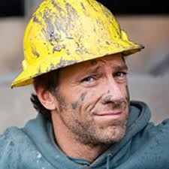
Let’s Get Dirty!
Notes:
In order to understand the Standards, we have to dig in and get dirty!

Slide 26
What do we want students to know and be able to do?
Decision Point 1

Slide 27
Use ratio and rate reasoning to solve real-world and mathematical problems. (6.RP.3)
Use ratio reasoning to convert measurement units; manipulate and transform units appropriately when multiplying or dividing quantities
Common Core Standard

Slide 28
Joe can mow a lawn in 2 hours. How long will it take him to mow three lawns?
Joe can mow three lawns in 4 hours. How long will it take him to mow six lawns?
If it took 7 hours to mow 4 lawns, then at that rate, how many lawns could be mowed in 35 hours? At what rate were lawns being mowed?
If it took 2 hours to mow 3 lawns, how much can be mowed in 20 minutes?
Jeremy has two 7-foot-long boards. He needs to cut pieces that are 15 inches long from the boards. What is the greatest number of 15-inch pieces he can cut from the two boards?
Assessment Items

Slide 29

Power of the
Assessment Big Idea

Slide 30
Standards (and objectives) are meaningless until you define how to assess them.
Because of this, assessments are the starting point for instruction, not the end.
Assessment Big Ideas

Slide 31
Sample Assessment Items
SBAC
NYS Common Core
Food for Thought

Slide 32

Unwrapping the standards
Step 4

Slide 33
Provides clarity for what students need to know & be able to do
Assists in developing Big Ideas & Essential Questions
Creates concrete & measurable learning targets
Stronger design of standards-based performance tasks
Increases alignment between standards & assessment
The Case for Unwrapping Power Standards
Larry Ainsworth, Unwrapping the Standards
Notes:
To emphasize the rationale for unwrapping Power Standards

Slide 34
unwrapping
Analyze standards for
CONTENT
SKILLS
What students need to know
What students need to be able to do
CRITERIA
Under what conditions
Notes:
Adapted from Larry Ainsworth and Kim Bailey/Chris Jakicic

Slide 35
Select a Power Standard
Underline the nouns
(TASK ANALYSIS)
Circle the verbs
Bracket any context or conditions for demonstrating knowledge and skills
Determine the level of thinking (Bloom’s or Webb’s DOK)
Identify the language of instruction needed to teach the standard
Protocol for Unwrapping Power Standards
Notes:
A systematic process for unwrapping power standards. Participants may want to engage in a Task Analysis of the important words/phrases in a standard to help reveal “hidden” learning or prerequisite knowledge needed in order for students to be proficient in a standard.
Refer participants to the following handouts: Unwrapping Template, Bloom’s/Webs

Slide 36
Ensure consistency of instructional rigor
Determine what success looks like
Employ the appropriate assessment method
Why do we need to identify the level of thinking at which a standard is taught?

Slide 37
Joe can mow a lawn in 2 hours. How long will it take him to mow three lawns?
Joe can mow three lawns in 4 hours. How long will it take him to mow six lawns?
If it took 7 hours to mow 4 lawns, then at that rate, how many lawns could be mowed in 35 hours? At what rate were lawns being mowed?
If it took 2 hours to mow 3 lawns, how much can be mowed in 20 minutes?
Jeremy has two 7-foot-long boards. He needs to cut pieces that are 15 inches long from the boards. What is the greatest number of 15-inch pieces he can cut from the two boards?
Assessment Items

Slide 38
Which Level?
RI.4.7
Bloom’s or Webb’s Depth of Knowledge (DOK)
Interpret information presented visually, orally, or quantitatively (e.g., in charts, graphs, diagrams, time lines, animations, or interactive elements on Web pages) and explain how the information contributes to an understanding of the text in which it appears.
Notes:
Use the provided chart for Bloom’s Taxonomy and Webb’s DOK to help determine the level of thinking one might consider for this standard.

Slide 39
Let’s unwrap RL.6-8.1!
Cite specific textual evidence to support analysis of primary and secondary sources.
Underline the nouns
Circle
the verbs
Place [ ] around criteria or conditions
Bloom’s or DOK?

Slide 40
Unwrapping rL.6-8.1
Cite [specific] textual evidence to support analysis of primary and secondary sources.
Underline the nouns
(content)
Circle
the verbs
(skills)
Bloom’s or DOK?
Place [ ] around criteria or conditions

Slide 41
Unwrapping template
SKILLS (verbs) | CONCEPTS (nouns) |  | BLOOM’S/DOK
Students need to be able to do… | Students need to know about… |  | What level of thinking?
Cite [with specificity] Support | Textual evidence Analysis of primary and secondary sources Author’s intent/reliability |  | DOK Level 3 Bloom’s 3-4
Topics/Big Ideas/Essential Questions Supporting analysis of primary and secondary sources with evidence How does textual evidence support and strengthen our thinking? How do primary and secondary sources differ in their interpretation of an event? |  | Language of Instruction(What language would you use to teach this standard?) Primary source Secondary source Textual evidence Analysis Intent & reliability
Notes:
Use the template to organize the information from the unwrapped standard.

Slide 42
Analysis of primary & secondary sources
Compare/
contrast
Author’s intent/view
Historical context
Task Analysis of
RL.6-8.1
Notes:
This slide demonstrates how one might “deconstruct” key words or phrases from the standards to reveal underlying skills, “hidden” learning, or prerequisite knowledge needed by students in order to be proficient.

Slide 43
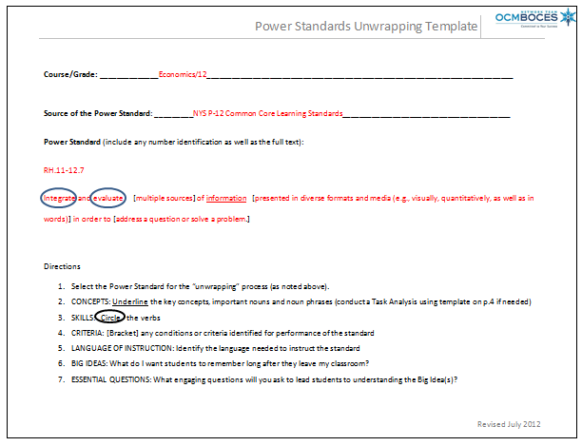
Notes:
Show participants a model of how to use the unwrapping template.

Slide 44
What do we want students to know and be able to do?
Decision Point 1

Slide 45
Standards
Learning Targets
Assessments
Where do Learning Targets come from?

Slide 46
Learning targets
Clear?
(student-friendly language)
Focused?
Appropriate?
Notes:
Recognize that learning targets go by many names: essential learnings, big ideas, essential understandings, enduring understandings, standards, benchmarks, goals, outcomes, essential questions. No matter the nomenclature the question we all need to ask and be clear about is “What is the intended learning?”
Are the learning targets clear (student-friendly language)?
Are the learning targets focused (not too many)?
Are the learning targets appropriate (connected to the standards or local curriculum)
Do the learning targets represent what was taught?
Do the learning targets help students progress to the next level?

Slide 47
Learning targets in student-friendly language
Inferencing at 2nd grade
I can make good inferences. This means I can make a really good guess based on clues from what I read.
Inferencing at 7th grade
I can make solid inferences. This means I can use information from what I read to draw a reasonable conclusion.
Notes:
Student-friendly language for learning targets.

Slide 48
Standard
Inferencing
Learning Target
Draw reasonable conclusions based on information in a text
Assessment
Reading Passage w/ Constructed Response
Strong Alignment

Slide 49
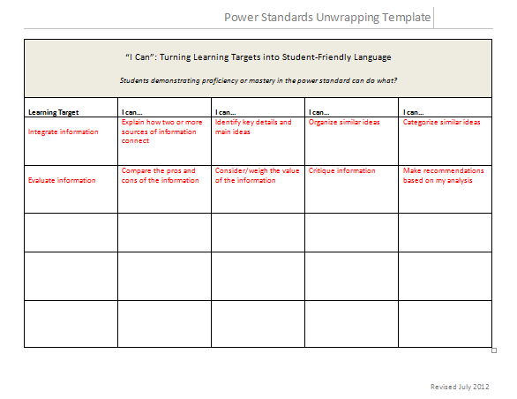
Notes:
Show example of how to turn Learning Targets into “I can...” statements

Slide 50
Learning Targets
Identify the type of learning target
Knowledge
Reasoning
Skill
Product
Notes:
There are four basic learning targets.
Knowledge targets represent the factual underpinnings in each discipline. Often stated using verbs such as “knows, lists, names, identifies, and recalls”.
Reasoning targets represent the mental processes demonstrating the use of knowledge in a discipline. Often stated using verbs such as “predicts, infers, classifies, hypothesize, compares, concludes, summarizes, analyzes, evaluates”.
Skill targets are performances that must be demonstrated and observed (heard or seen) to be assessed. Knowledge targets always underlie skill targets.
Product targets require students to create products such as “notate music, scatter plots, research paper”. Be careful in not confusing products with tasks. For example, creating a lamp is not the intended learning, but rather what we use to assess students’ ability to properly use machinery, join pieces of wood, or how to finish a surface. A research paper serves both to assess students’ reasoning abilities while also being a focus of the curriculum itself.

Slide 51
Knowledge | Reasoning | Skill | Product
Know List Name Identify Tell Examine Recognize Explain Understand Describe Define | Compare Contrast Distinguish Analyze Organize Infer Deduce Predict Interpret Hypothesize Sort Evaluate Prove Judge Support Justify Classify | Play Do Use Observe Measure Explore Demonstrate Carry out Model Listen Perform Question Conduct Speak | Make Generate Design Construct Invent Produce Draw Write Create Develop
Notes:
Identifying the verbs in the standards helps to determine which learning target is being exemplified.

Slide 52
Task?
Target?
Make a desk
Skillful use of machinery
Joining pieces of wood
Finishing wood surfaces
Know Your Learning Targets
Notes:
Be sure to understand the difference between the task (the activity students will engage in) and the target (what they are to learn by engaging in the activity). This is crucial to creating an accurate assessment.
In the example above, we use the product of the “desk” to evaluate students’ achievement of the knowledge, reasoning, and skill targets identified.

Slide 53
Task?
Target?
Write a lab report
Write a lab report
Know Your Learning Targets
Notes:
Be sure to understand the difference between the task (the activity students will engage in) and the target (what they are to learn by engaging in the activity). This is crucial to creating an accurate assessment.
In the example above, written products such as lab reports, research papers, etc. are often the target of the curriculum. Therefore, they serve both as the vehicle by we which we judge knowledge and reasoning proficiency as well as the development of the product.

Slide 54
Designing Quality Common Assessments
A Five Step Process
Decide What to Assess
Decide How to Assess
Develop Assessment Plan
Write the Assessment
Review the Assessment
Notes:
Outlined above is a five-step process adapted from the book Common Formative Assessments.

Slide 55
How will I know students have learned?
Decision Point #2
Notes:
Once you’ve decided on what students will learn, your attention turns to measuring how well students have learned.

Slide 56
Decide how to assess
A 3rd grade team wants to know how well students can tell time.
How might they assess this knowledge?
Notes:
Have participants share their ideas for this question. Hopefully, there will be a variety of ways shared by the group that you can begin to categorize them.

Slide 57
Decide HOw to assess
Determine your assessment strategy
Selected Response
Constructed and extended written response
Performance assessment
Notes:
Selected response includes items such Multiple Choice, T/F, and matching type questions.
Constructed/Extended written response items require students to provide their own answer to a question or prompt. Examples are short or long essay prompts. Graphic organizers are also considered to be an example of this type.
Performance assessments ask students to demonstrate their understanding of a learning target by performing in front of the teacher, who evaluates them against a rubric.
Each method is equally viable as an assessment strategy as long as the following points are considered:
Does the selected strategy accurately measure the intended learning target at the level of thinking it was taught?
Does the selected strategy provide timely turnaround of the information needed for teachers and students to determine next steps?
Does the selected strategy require the use of a rubric? Will that rubric be implemented consistently across teachers?

Slide 58
Assessment methods
Method | Ideal for assessing | Examples | Scoring
Selected Response | Knowledge-level learning targets | Multiple Choice Fill-in-the-blank T/F Matching | Number or percent of points Rubric
Extended written response | Chunks of knowledge that interrelate & student reasoning | Essay Short Answer
Performance Assessment | Learning best achieved through observable actions (skills) or the development of products | Playing an instrument Changing the oil in a car Conversing in a foreign language
Notes:
There are three basic assessment methods. This chart provides examples of each method, what it best assesses, and how it can be scored.

Slide 59
Decide HOw to assess
Assessment Strategy Considerations
Accurately measure the intended LT at the level of thinking it was taught?
Provide timely turnaround?
Require a rubric?
Notes:
Selected response includes items such Multiple Choice, T/F, and matching type questions.
Constructed/Extended written response items require students to provide their own answer to a question or prompt. Examples are short or long essay prompts. Graphic organizers are also considered to be an example of this type.
Performance assessments ask students to demonstrate their understanding of a learning target by performing in front of the teacher, who evaluates them against a rubric.
Each method is equally viable as an assessment strategy as long as the following points are considered:
Does the selected strategy accurately measure the intended learning target at the level of thinking it was taught?
Does the selected strategy provide timely turnaround of the information needed for teachers and students to determine next steps?
Does the selected strategy require the use of a rubric? Will that rubric be implemented consistently across teachers?

Slide 60
Designing Quality Common Assessments
A Five Step Process
Decide What to Assess
Decide How to Assess
Develop Assessment Plan
Write the Assessment
Review the Assessment
Notes:
Outlined above is a five-step process adapted from the book Common Formative Assessments.

Slide 61
Develop the assessment plan
Design the Assessment
Measure what you’ve taught (identified learning targets)
Assess student learning at the cognitive level the information was taught
Notes:
Two major considerations when developing the assessment plan. Show example of the Assessment Planner map as a model.

Slide 62
Develop the assessment plan
Consider the sample size
How many items do I need to accurately assess a learning target?
Triangulate
Notes:
Assessment experts often refer to “triangulation” of data sources to provide a more complete picture. Think about providing a minimum of three questions to determine students’ understanding of a learning target. If the thinking involves both knowledge and application, it is best practice to combine constructed response and selected response type items.
Consider, too, the turn-around time you’ll need to analyze the data as you determine the length of your assessment.

Slide 63
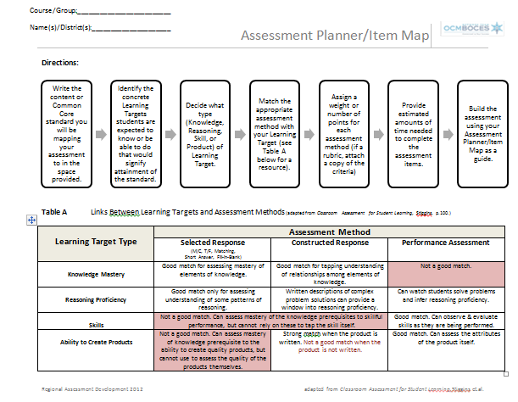
Notes:
Show participants the example of how to fill out the assessment planner map.

Slide 64
Designing Quality Common Assessments
A Five Step Process
Decide What to Assess
Decide How to Assess
Develop Assessment Plan
Write the Assessment
Review the Assessment
Notes:
Outlined above is a five-step process adapted from the book Common Formative Assessments.

Slide 65
Directions
Formatting
Answer Key
Acceptable Answers
Cover Page
Multiple Versions
Write the Assessment
Notes:
Key points to consider when creating the assessment.

Slide 66
Printer
Copier
Snipping Tool
Dropbox
Standards
Current Assessments
Tools to Assist in Creating the Assessment

Slide 67
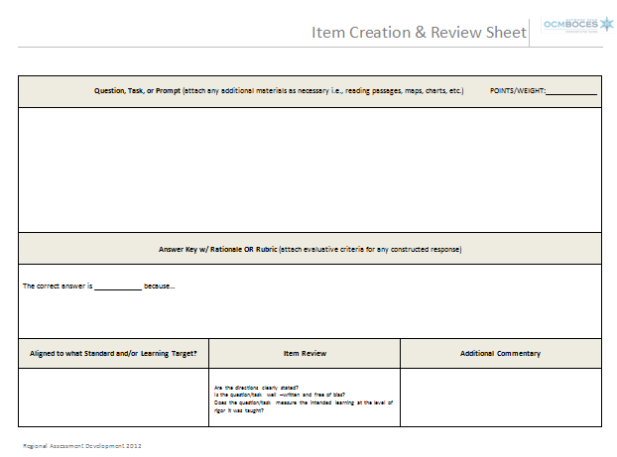
Notes:
Refer participants to the Item Creation tool as a resource for helping in their work.

Slide 68
Write the assessment
General Guidelines
Selected Response Items
Constructed Response Items

Slide 69
Multiple-Choice Questions
Advantages
Can measure a variety of objectives
Easy to score
Can cover lots of material efficiently
Carefully crafted distracters can provide diagnostic information
Disadvantages
Multiple-guess
Can be difficult to identify plausible distractors
Notes:
A majority of the assessments given are in the form of multiple-choice questions. Therefore, we focus on this particular method due to its familiarity and high rate of usage by classroom teachers.

Slide 70
Writing Quality Multiple Choice Questions
#1 Keep the wording simple
Not this… | When scientists rely on magnets in the development of electric motors they need to know about poles, which are?
But rather this… | What are the poles of a magnet called?

Slide 71
Writing Quality Multiple Choice Questions
#2 Ask a full question in the stem (the part that precedes the options)
Not this… | Between 1950 and 1965 Interest rates increased. Interest rates decreased. Interest rates fluctuated greatly. Interest rates didn’t change.
But rather this… | What was the trend of interest rates between 1950 and 1965? Increased only Decreased only Increased, then decreased Remain unchanged

Slide 72
Writing Quality Multiple Choice Questions
#3 Eliminate clues to the correct answer within the question
Not this… | All of these are examples of a bird that flies, except an Ostrich Falcon Cormorant Robin
But rather this… | Which of the following is an example of a bird that can NOT fly? Ostrich Falcon Cormorant Robin

Slide 73
Writing Quality Multiple Choice Questions
#4 Highlight critical, easily overlooked words i.e., NOT, MOST, LEAST, EXCEPT
Not this… | Which of the following is an example of a bird that cannot fly? Ostrich Falcon Cormorant Robin
But rather this… | Which of the following is an example of a bird that can NOT fly? Ostrich Falcon Cormorant Robin
Notes:
Underlining and/or capitalizing words that significantly alter the meaning of the question is MORE effective than italicizing or bolding.

Slide 74
Writing Quality Multiple Choice Questions
#5 Remove repetitive words within each option; instead, reword the stem
Not this… | Between 1950 and 1965 Interest rates increased. Interest rates decreased. Interest rates fluctuated greatly. Interest rates didn’t change.
But rather this… | What was the trend of interest rates between 1950 and 1965? Increased only Decreased only Increased, then decreased Remain unchanged

Slide 75
Writing Quality Selected Response Questions
Reduce the “guessing” games
Eliminate “throw away” choices
Put choices in a logical order such as alphabetical or small to large
Avoid equal-sized lists in matching questions
Choose distractors carefully; plausible, yet illuminate errors in thinking

Slide 76
Writing Quality Selected Response Questions
Avoid bias or distortion
Unclear directions or expectations
Poor target-method match
Inappropriate context or vocabulary
Vague evaluative measures

Slide 77
Writing Quality constructed response Questions
Provide context for student answers
Environmental issues can have social, economic, and political effects on our country. For example, the 2010 oil spill in the Gulf of Mexico affected our economy through the tourism industry – an economic effect. The greenhouse effect has resulted in many new laws reducing car emissions – a political effect. Choose one environmental issue that has such an impact and explain what the social, political, and economic impact was.

Slide 78
Writing Quality constructed response Questions
Novel (new) Prompt
Describe the effects of the Civil War on the economy of the South.
Recall?
OR
Applying to a new situation?
Notes:
Be cautious in writing questions for constructed response. If asking students to describe the effects of the Civil War on the economy of the South was a topic of discussion during the unit, they are only being asked to remember or recall what was discussed. If students are asked how the economy of the North was affected (and this was not a focus of class discussion), the assessment determines whether students are able to understand the reasoning around this concept and apply it to a new circumstance.

Slide 79
Designing Quality Common Assessments
A Five Step Process
Decide What to Assess
Decide How to Assess
Develop Assessment Plan
Write the Assessment
Review the Assessment
Notes:
Outlined above is a five-step process adapted from the book Common Formative Assessments.

Slide 80

Review the assessment
Are the directions clear?
Will students understand what you are asking them to do and why?
Are the leaning targets accurately assessed and represented?
Are the questions written according to best practice?
Take the assessment
Notes:
Carefully examine the assessment prior to administration. Catching potential problems will ensure validity and reliability are intact.

Slide 81
At what level must a student perform in order to be successful on achieving the standards?
3 on a 4 point rubric
85% or above
Strong vs. Weak examples
Answering 2 out of 3 questions targeting a specific standard
What does success look like?
Notes:
Participants must decide how they will determine the proficiency levels of students taking the assessment. Use the targets to determine your level of proficiency. For example, a student who scores a “3” out of a 4 point rubric is proficient or a student who correctly answers 3 out of 5 multiple-choice questions is proficient.

Slide 82

Where do you go from here?

Slide 83
Designing Quality Common Assessments
A Five Step Process
Decide What to Assess
Decide How to Assess
Develop Assessment Plan
Write the Assessment
Review the Assessment
Notes:
Outlined above is a five-step process adapted from the book Common Formative Assessments.

Slide 84
Contact information
Thank
you!
Thank
you!
Renee Burnett
rburnett@ocmboces.org
Thank
you!

