Slide 1
BCIC Meeting
September, 2012

Slide 2
Welcome
Introductions
Overview of Agenda

Slide 3
SED Updates
Computer Based Assessment
SED Organizational Changes
Global Studies Discussion by Regents
SED’s Portals
Field Testing
Growth Scores for 4-8 Teachers
Skills-based credential

Slide 4
ITD

Slide 5
CI&A
2012-2013 Programming
Summative Assessments:
Summer 37 different assessments
Fall 19 additional assessments
Put on disks as soon as final group completes- first part of October

Slide 6
Literacy Programs
Overview of Red System Sept 26
Registration open on MLP for Red System

Slide 7
Teacher Centers
CNY/Oswego
Continue PBL support
Continue unit planning support
After school sessions
SLO help available
Teacher Conversations

Slide 8
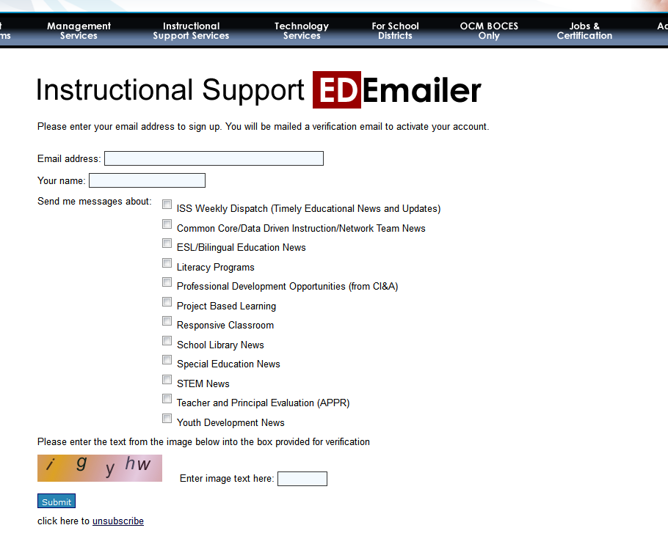

Slide 9
Social Media and ISS
???

Slide 11
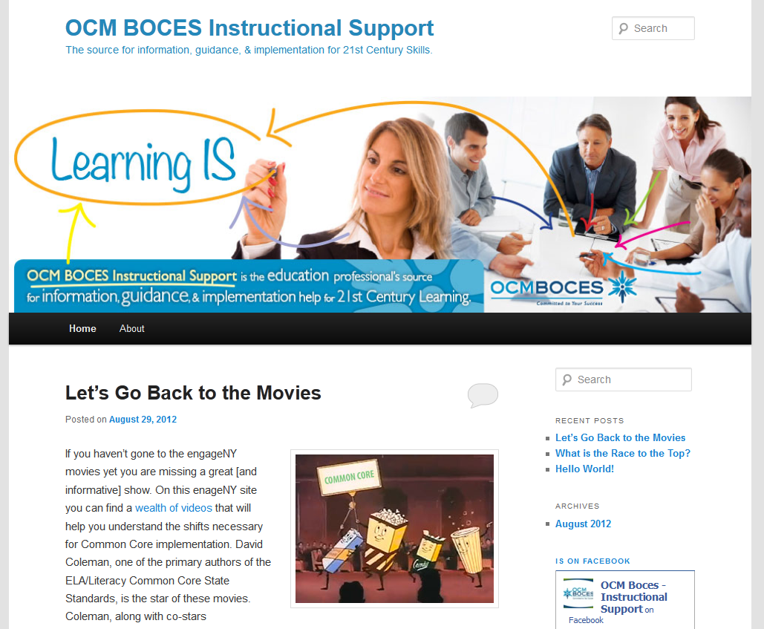

Slide 12
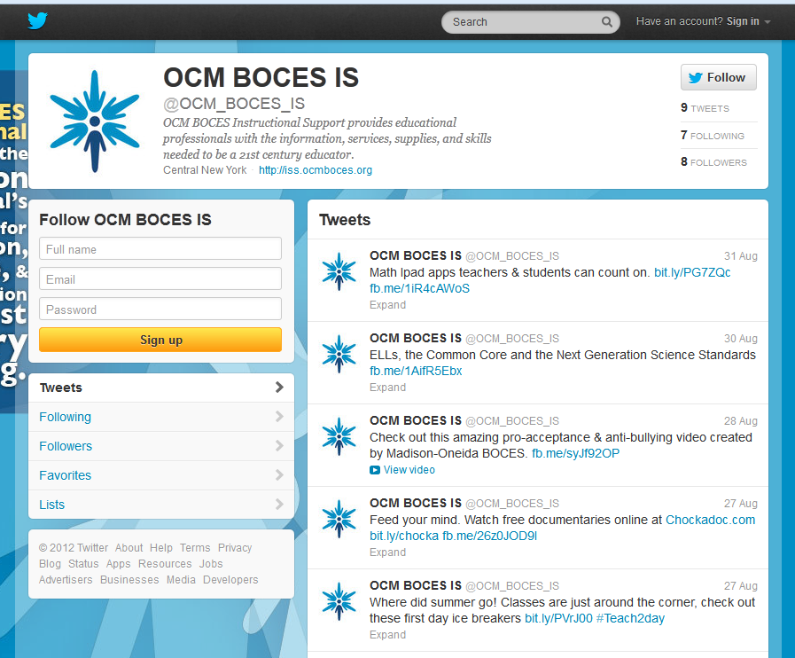

Slide 13
Race To The Top
(the Regents Reform Agenda)

Slide 14
Standards
Adopt
Adapt
Refer [to]

Slide 15
NYS Curriculum Modules for ELA and Math

Slide 16
Curriculum Modules P-2 ELA
NYSED is partnering with Core Knowledge
Phased implementation:
Year 1:
Listening and Learning modules
Ongoing professional development with educators
Year 2:
Student skills development modules
Ongoing professional development with educators

Slide 17
Listening and Learning Strand
Core Knowledge
Building background knowledge through text choice & purpose
Build cognitive & processing skills
Read-Aloud
Attend to the rigor of the CCLS
P-2 ELA Curriculum Plan

Slide 18
Curriculum Modules 3-5 ELA
NYSED is partnering with Expeditionary Learning to develop comprehensive materials in Grades 3-5 that progress across the school year and across the grades.

Slide 19
Whole Group Instruction
Expeditionary Learning
Text Complexity
Close Reading
Content-rich
Evidence
3-5 ELA Curriculum Plan

Slide 20
A Story of Units
Common Core, Inc.
Pacing Map
Build understanding of units from the concrete to the pictorial to the abstract
Pre/Post testing document
Math is a logical sequential story
PK-5 Math Curriculum Plan
Notes:
The goal of A Story of Units is to build students’ understanding of units from the concrete to the pictorial to the abstract as they move, seamlessly, from grade to grade.

Slide 21
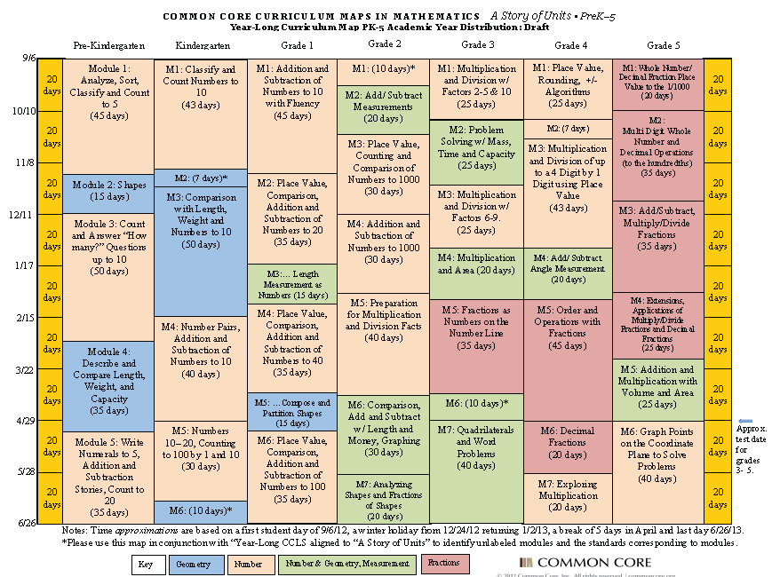
Year Long Math Curriculum Map PK-5
EXAMPLE!
Notes:
Add pre/post doc. Picture if possible. Provide both as a handout.

Slide 22
Standards
Adopt
Adapt
Refer [to]

Slide 23
ELA
Complexity
Knowledge
Math
Focus
Coherence
Evidence
Rigor
PARCC Sample Assessment Items
www.parcconline.org

Slide 24
ELA
Grade 3
Grade 6
Math
Grade 3
Grade 4
Grade 7
Grade 10
Grade 6
Grade 7
High School
PARCC Sample Assessment Items

Slide 25
Math
FIRST address preApril/postApril
CONTNUE to build understanding about what kids are now expected to be able to do
BE CAREFUL about rushing to adopt programs, buy series, or take things from engageNY

Slide 26
Data-Driven Instruction
Connect common formative/interim assessments to SLOs
October 9th Conference Day plans
We can do for you
Turn-keyable by you
Do for you another time
Two goals
Calendar for assessments (w/ priorities)
First assessment ready

Slide 27
September
June

Slide 28
September
June
SLO Baseline
SLO Summative

Slide 29
Common Formative Interim Assessment
Common Formative Interim Assessment
Common Formative Interim Assessment
September
June
SLO Baseline
Common Formative Interim Assessment
Common Formative Interim Assessment
SLO Summative

Slide 30
Common Formative Interim Assessment
Common Formative Interim Assessment
Common Formative Interim Assessment
September
June
SLO Baseline
Common Formative Interim Assessment
Common Formative Interim Assessment
SLO Summative

Slide 31
Common Formative Interim Assessment
Common Formative Interim Assessment
Common Formative Interim Assessment
September
June
SLO Baseline
Common Formative Interim Assessment
Common Formative Interim Assessment
SLO Summative

Slide 32
Data-Driven Instruction
AM 2.5 hrs
Balanced Assessment System
Six Shifts of DDI
Assessment Construction 101
Process for getting from SLO to calendar for common formative/interim assessments
Process for getting first assessment done
PM 2.5 hrs
Work time (w/ support)
Should be replicable for other interims

Slide 33
Data-Driven Instruction
We need to know:
Who wants us to help?
Who wants turn-key support?
Who wants other arrangement?

Slide 34
Long-term Planning

Slide 35
Other Business

Slide 36
Enterprise America
Construction proceeding at WCNY
Now arranging business
Open to suggestions
In services guide (with price structure)
Via Science Center ($ and scheduling)

Slide 37
SLS Merger Study
Task Force formed
RFP issued (going to Boards)
Center for Governmental Research
Target for study conclusion is end of calendar year

Slide 38
Assessment

Slide 39
3-8 Scoring
Affirm (or not) last years structure
Review last year’s debriefing
Consider some additional standardization
Identification of next steps

Slide 40
Regents Scoring
Regional scoring not really “required”
Trying to identify needs – not so easy
Discussion
Identification of next steps

Slide 41
Next BCIC Meeting
October 18, 2012

